Slide 1
Major Challenge in Systems Engineering
One of the major challenges in engineering systems is to get all of the parts, components and subsystems to work together
Getting them to work together and understanding/controlling their interaction is called Systems Integration
Notes:
Getting all of the parts to work together is called systems integration.

Slide 2
Major Obstacle To System Integration
One of the major obstacles to successful system integration is the fact that a big part of the job in building systems is done below the subsystem level
This is called “discipline” engineering because it often utilizes specific disciplines
  Power engineering
  Structural engineering
  Mechanisms engineering
  Data Systems Engineering
  Etc…
Because most engineers are trained in disciplines, they tend to pick up that discipline as their world view
  “When your only tool is a hammer, all of your problems begin to look like nails”
Systems engineering is the discipline which enable us to look at the whole system and understand its integration and interactions

Slide 3
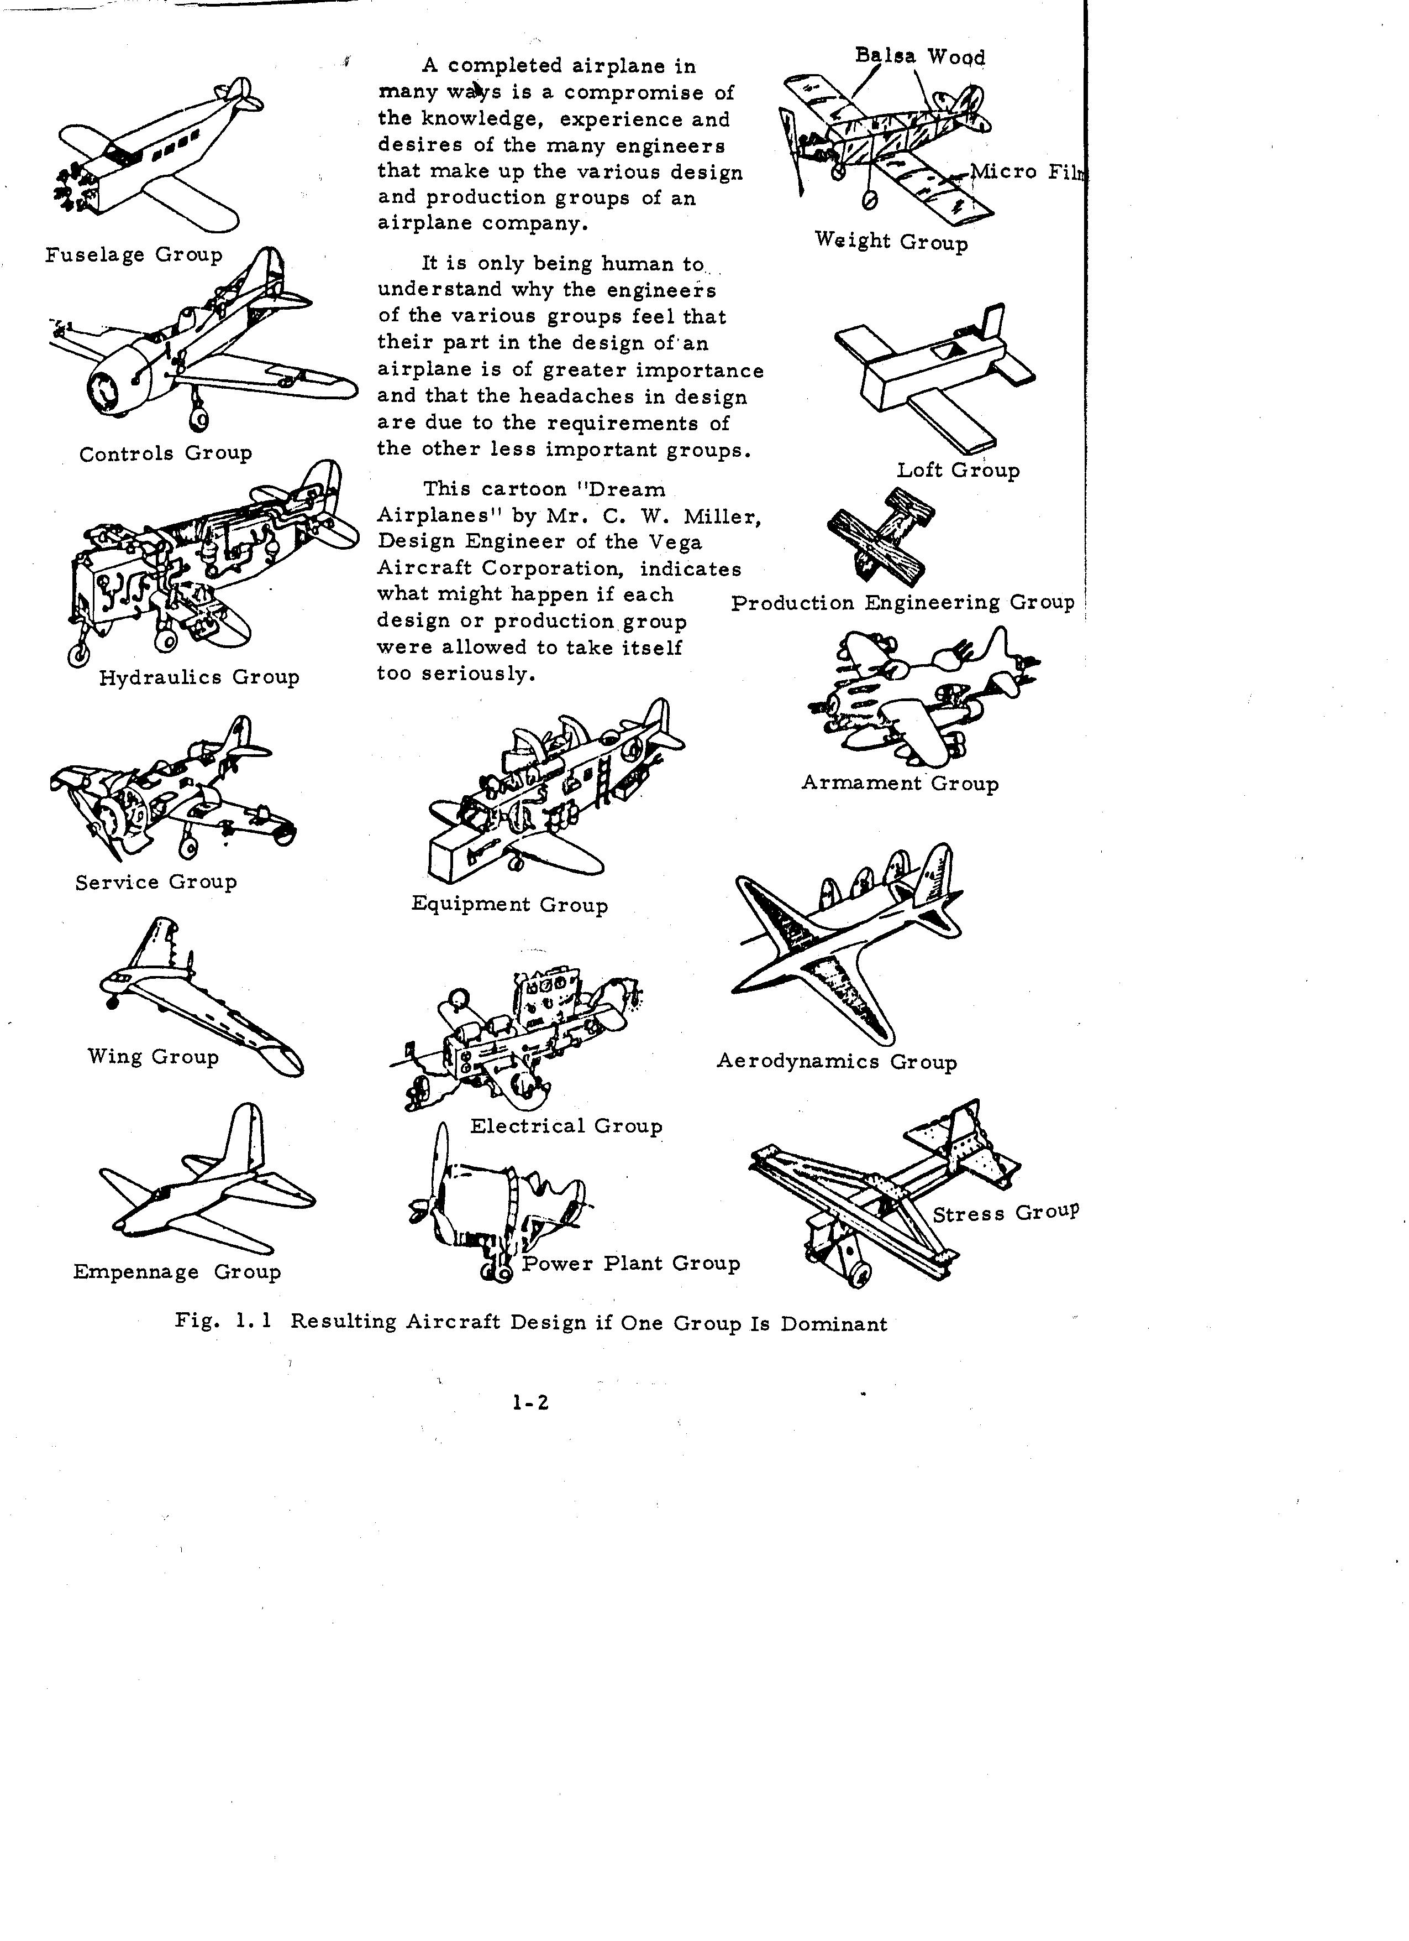
Notes:
This cartoon was produced in the 1930’s-1940’s to describe the major sociological problem in systems integration. Aircraft were one of the first types of complex systems that engineers tried to integrate. As a result, many of the techniques in systems engineering originated in aerospace engineering.
When engineers work in a given discipline for a significant length of time their thinking tends to become dominated by their discipline specific concerns, techniques and issues. They figuratively, and sometimes literally, start thinking of the aircraft as just their subsystem. They also want to minimize the design problems in their particular area – to optimize their effort versus optimizing the total design. So for example to a weight engineer – they want the minimum weight materials (balsa and mylar in the cartoon) in their ideal aircraft because it is the most optimized in terms of their discipline – weight.
Structures engineers in my experience, tend to be guilty of this because they often say “the structure is the system because everything ties into it”/ What would be more correct would be to say that the structure is an important system integrating function because it provides mechanical support to almost all components. (Systems that don’t tie into the structure – consider software ! Consider aerodynamics !)
At any rate, with everyone having their own unique view over what’s important in the system and trying to build their own ideal version of the aircraft (easy to build, lightest weight, simplest to analyze, most equipment installed) it becomes very easy for the pieces not to work together to accomplish the overall function. This especially true when one area has a strong spokesman or personality driving it.

Slide 4
When one requirement dominates design, you rarely get a world champion design
Notes:
Often in a design, one requirement or discipline drives the entire system design in a desire to achieve a systems performance goal. When this happens some unusual designs result and they rarely achieve their goals. The designs that are usually very successful and long lasting (“World-beaters”) are those that balance all of the subsystems to optimize total system performance.
Systems engineering has often been called the art of sub-optimizing each individual subsystem in a way that optimizes the total system performance.
For example, the battery designer might want to design the biggest possible battery for the electrical system. It may be desirable to have a great battery in a car or an aircraft, but left unchecked (the battery can be as big as a house !) the design becomes dominated by the battery and system performance degrades
Systems engineering is the art and science of making sure that we have just the right of battery, structure, hydraulics, etc.. to optimize performance of the system so that it meets performance requirements.

Slide 5
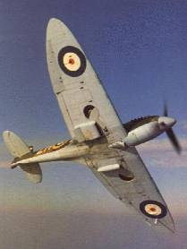
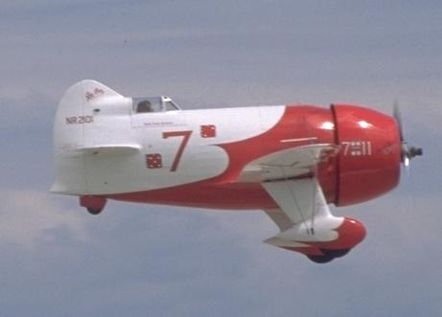
Supermarine Spitfire
Mission – Fighter Aircraft
Optimized for aerodynamic performance
Suboptimal – stability – nasty spin mode
GeeBee
Mission – Racer
Optimized for engine and minimal drag
Suboptimal - controllability
Notes:
Consider the Supermarine Spitfire – an amazing aircraft that was produced all through WW2. You will note that it has elliptical wingtips, one of the few aircraft in the world ever produced this way. The elliptical wingtip provides the minimum drag that is produced as a by-product when a wing is generating lift (induced drag). Unfortunately, the elliptical wingtip causes stability problems for the entire aircraft because the aircraft wingtip stalls first and can cause a nasty spin.
The GeeBee was a racing aircraft that was designed with the inherent belief that the thing to do to wing a race was to have the biggest engine in the race. The lack of integration in this aircraft is evident to a modern aeronautical engineer. The aircraft is sized to carry this huge engine which has large flat face and produces huge drag. Then in order to save weight, they decided to use fixed landing gear. This also puts huge drag in the aircraft, which they tried to minimize by putting the rounded structures around the tires. Then look at the tail, where they tried to reduce weight and drag by tiny controls. This is really inadequate and makes an aircraft very hard to control. The first GeeBees built crashed and were finally mastered by Jimmy Doolittle, an amazing and daring pilot and the first PhD in aeronautical engineering in the US. But this design philosophy was not continued in other aircraft.
Aeronautical engineers say “if the design looks good, it will fly good” – this is a homey way of saying “if the design balances all systems it will have good performance”

Slide 6
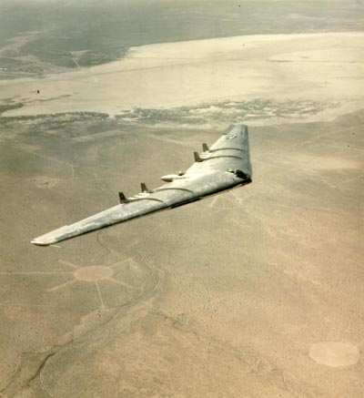
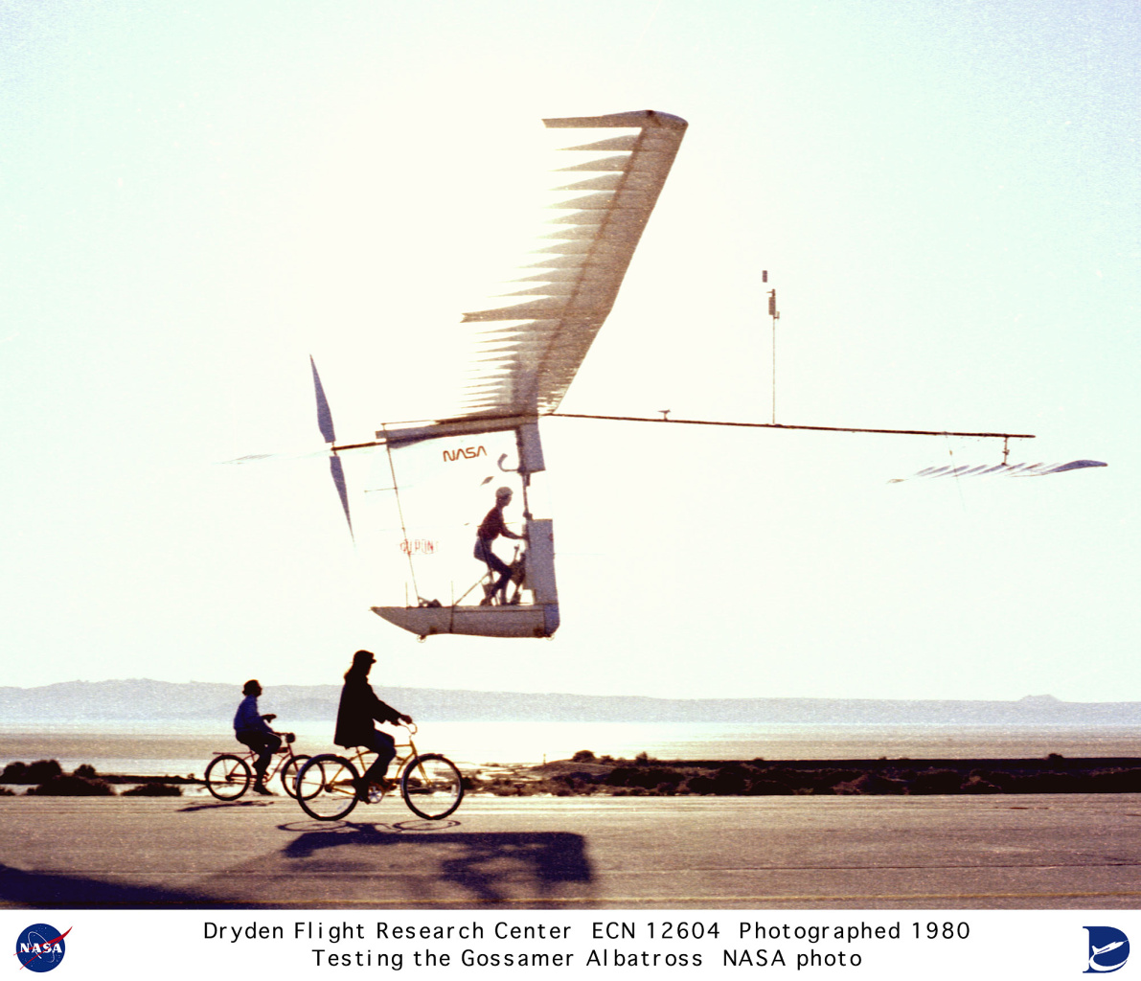
YB49 Flying Wing (1940’s) precursor to modern B-2
Mission - Long Range Bomber
Optimized for range by aerodynamic performance and large wing tanks
Suboptimized for stability and control
Gossamer Albatross
Mission – Human Powered Flight Demonstrator
Optimized – Minimum Weight and maximum lift so that vehicle could fly within performance of human engine
Subotimized – strength – very fragile
Notes:
The YB-49 was built by Jack Northrop with the idea of the perfect aircraft design of all wing. It had huge fuel tanks and the minimum possible drag. Unfortunately the design naturally is unstable and wants to spin like a frisbee.
This design wasn’t a world beater, despite the fact that it was very efficient. It re-emerged decades later as the B-2, not because of its efficiency or range, but because the all flying wing had a low radar cross section and thus hard to detect (stealthy). The design only became practical when computers and flight controls had evolved to stabilize the aircraft.
The Gossamer Albatross was constructed to win a prize for human powered flight. Because the amount of propulsion power was limited to that which a human could produce, everything had to built tow work within those limits. This led to a large and fragile structure. although the prize was won, it would never be a practical device as the structure is easily torn apart by the wind.

Slide 7
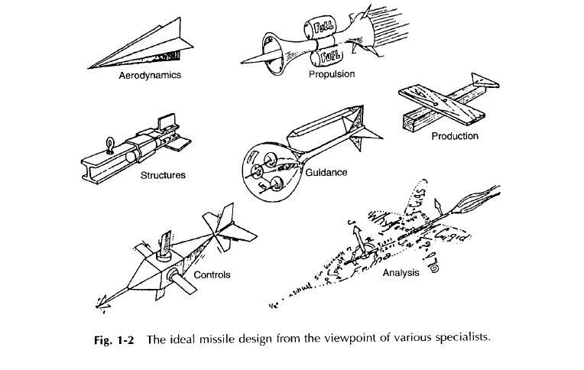
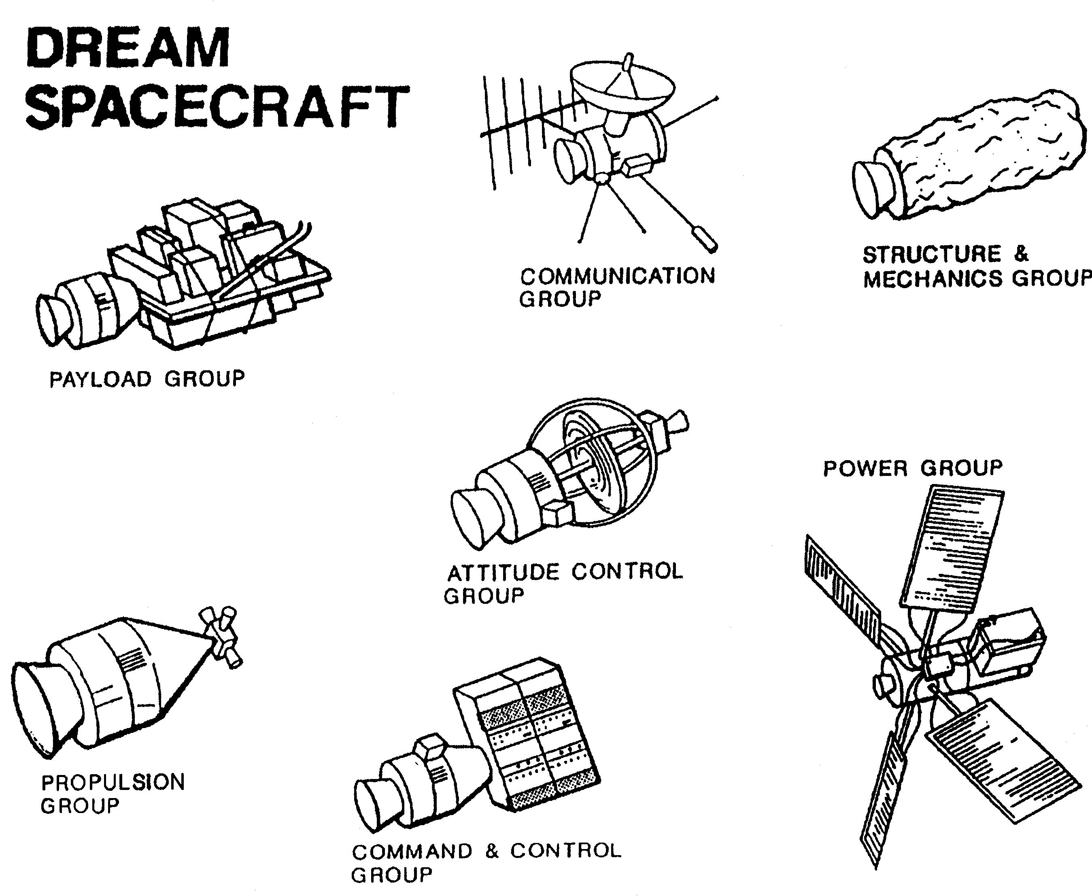
Phenomena of discipline view happens in all systems
Notes:
This phenomena happens to all sorts of devices – cars, planes, trains.. It doesn’t matter. The original cartoon spawned similar cartoons describing missiles and human spacecraft. M
I particularly like the view of the missile by the analysis community – as just a set of equations flying and no physical structure !

Slide 8
Important Realization For A Systems Engineer
There is no one single best design for an airplane, spacecraft, missile or anything else
The measure of “goodness” is how well it meets a specific requirement
  An airplane that is a great fighter makes a lousy cargo carrier and vice versa

Slide 9
Evolution of Systems Engineering
One of the primary sources of systems engineering was American Telephone and Telegraph (AT&T)
  Research arm of AT&T was Bell Telephone Laboratories (“Bell Labs”)
  Western Electric manufactured everything for AT&T, including prototype hardware
  Bell Labs developed a method of formal specifications for communicating about prototype hardware
MIT was responsible for developing radar systems and worked with Bell Labs on gun fire control systems during WWII
MIT had significant problems integrating the MIT radar and Bell Labs gun control system on a project called the SCR-584 Fire Control System
  They soon realized that the electronics acted differently when integrated together then when they were tested separately
As these systems evolved during the war, it became clear that a systems integrator was required
Notes:
The SCR-584 was designed to deal with the problems of using a radar to shoot down an aircraft. The spotter points the sighting device at the target. The radar locks on and figures out how much to lead the target for the time of flight of the bullet to the target and also compensates for the rolling and pitching of the ship. This involves integrating many different types of components – the control system for the gun, the radar, the spotting device.

Slide 10

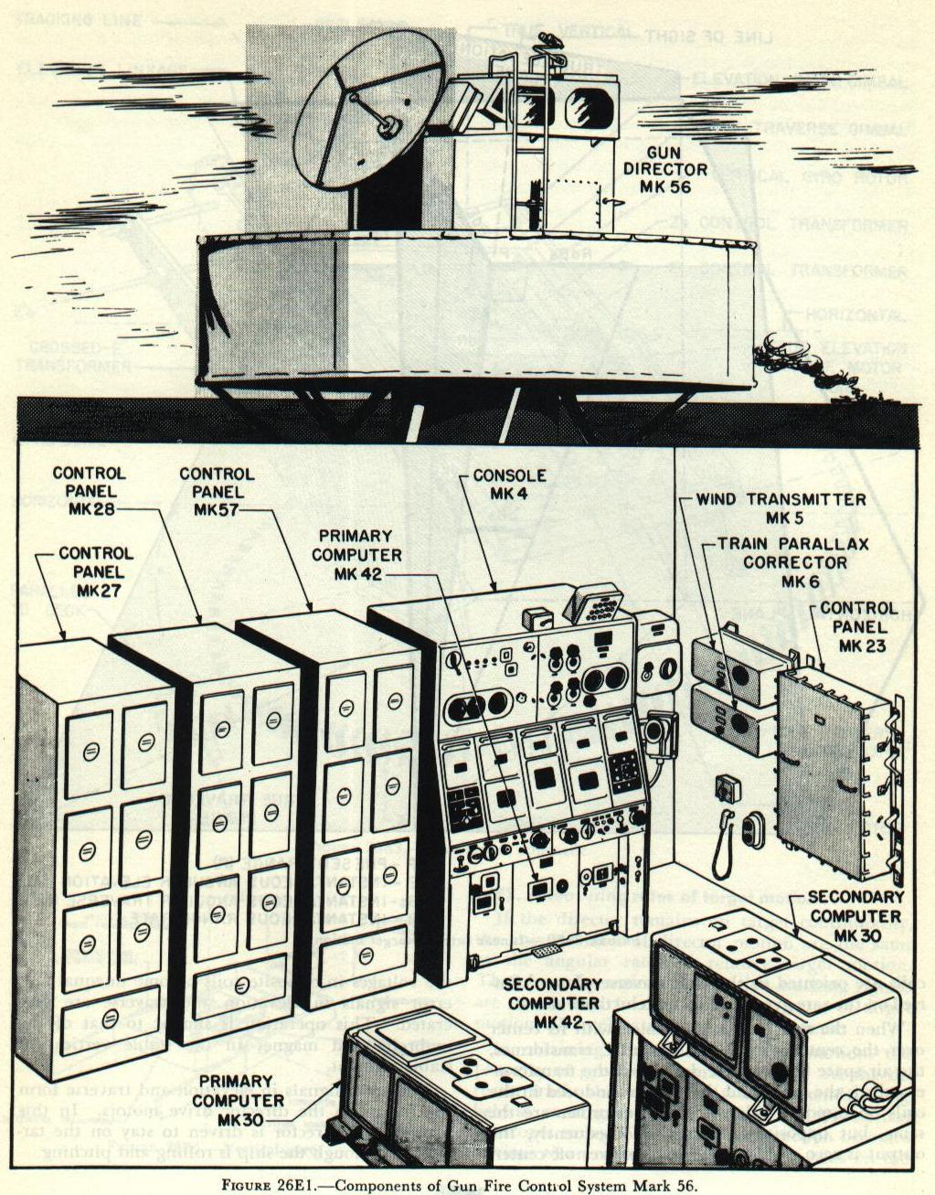
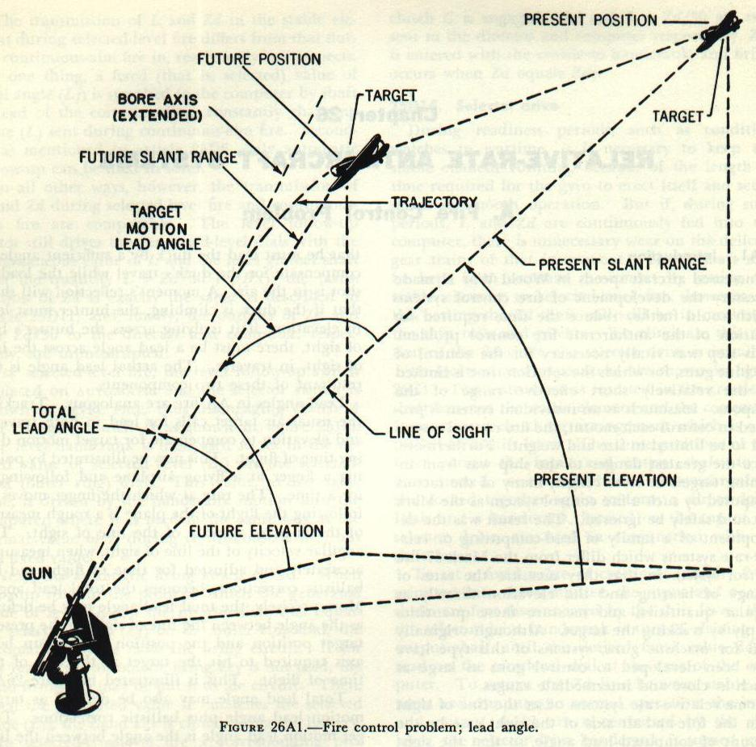
Western Electric Telephone – ca 1949
Mk 56 Gun Fire Control System
Notes:
It is hard for modern students, who live with cell phones, Iphones and blackberry’s, to realize that at one point all of the telephone sin the country were owned by the phone company and rented on a monthly basis. They were all manufactured by Western Electric, the manufacturing arm of AT&T. AT&T did an amazing job of integrating these simple components into a nationwide telephone system.
The diagram shows the problem of a gun control system. You can’t just shoot the gun where the aircraft is now because the aircraft is moving and won’t be there when the bullet arrives there. A radar is used to determine the velocity of the target and the system computes where to aim the gun so the bullet arrives at the target at the same time that the aircraft does !

Slide 11
Evolution of Systems Engineering
MIT (Ivan Getting) took this role on in 1945 on the Mark 56 gun control system
  Adopted Bell Labs specification techniques
  Became the center of a web of communications between many contractors and the users
  Established a formal system of systems integration
Getting took these ideas to the USAF through his role on the USAF Scientific Advisory Board and in the courses he taught at MIT
These ideas were incorporated by Simon Ramo in the AIM 4 Air to Air Falcon Missile
Ramo-Woolridge (later Thompson-Ramo-Woolridge- TRW) brought these ideas to USAF ballistic missile development in the 50’s and 60’s
These ideas then moved into the US Manned Space Program and went everywhere from there
Notes:
The AIM 4 Air to Air missile was one of the first guided missiles ever produced which were steered by a radar beam from launch to the target.
Developed by Hughes Electronics by Simon Ramo. Hughes Electronics dominated the a aircraft electronics business and the eccentric Howard Hughes so irritated the Secretary of Defense that he encouraged Ramo and Woolridge to defect to form their own company – which eventually became TRW.

Slide 12
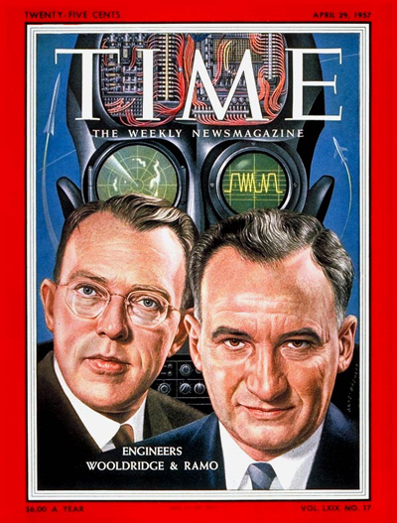
Notes:
This April 1957 issue of TIME magazine featured Woolridge and Ramo on the cover and discussed how the emerging field of systems engineering was going to affect the future.

Slide 13
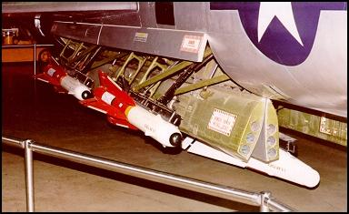
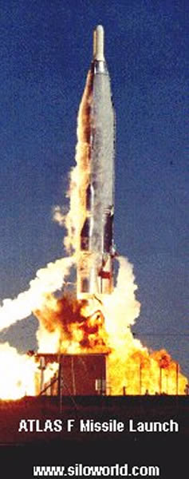
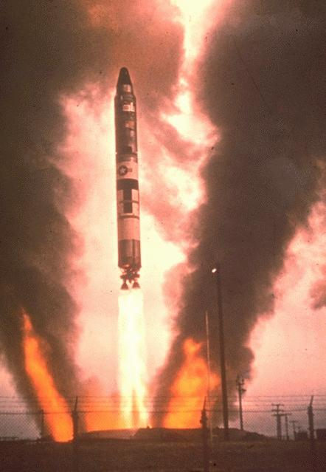
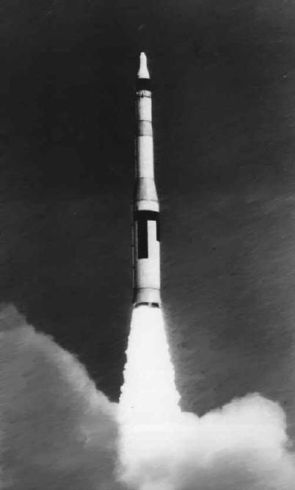
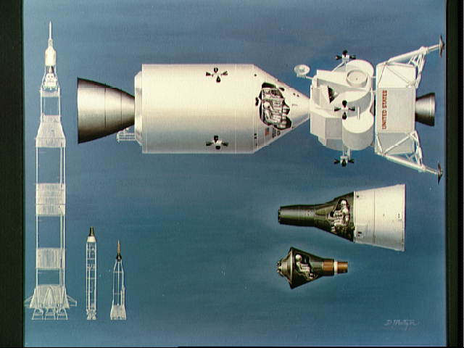
Evolution of Systems Engineering
AIM4 Falcon Missile
Air To Air Missile
Mercury/Atlas, Gemini/Titan and Apollo/Saturn
Atlas ICBM
Titan ICBM
Minuteman
ICBM
Notes:
Ramo and Woolridge took their experience from AIM4 Falcon and formed R-W (which later became TRW) became the systems engineers and systems integrators on the Atlas, Titan and Minuteman ICBMs for the United States Air Force. This experience was transplanted by into the human spaceflight programs where systems engineering was key to success. The tools and techniques of systems engineering then spread following the success of Apollo to other industries. Systems Engineering which has contributed to the products which dominate the modern world, including the internet, is one of the major benefits of human spaceflight to society.

Slide 14
Systems Integration –
The Vee Model
The Vee Model addresses the technical aspect of the project cycle and represents the sequence of project events.
The VEE model starts by determining the high level systems requirements. A system design at the high level is established which allocates functions and requirements to subsystems.
Those allocated system requirements are broken down into specific requirements for subsystems, components and parts.
Specific designs are done for the subsystems, components and parts and then the parts are manufactured and assembled.
Parts and components are tested to see if they meet the component and part requirements.
Parts and components are assembled into subsystems which are tested to subsystem requirements..
Then the entire system is assembled and tested to the top level system requirements.

Slide 15
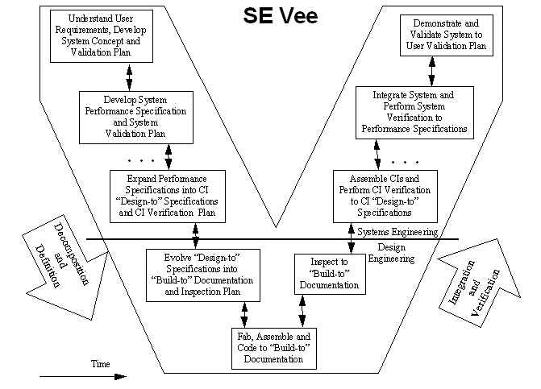
A CI is a “Configurable Item” – basically a product that is
delivered as a complete unit. A system is made of many CI’s.

Slide 16
What’s Wrong with the VEE ?
All the integration is pushed off to the end
  Integration is usually the most difficult part
  Hard to maintain support for a project when all you can demonstrate is pieces
  Hard to iterate with users/get feedback on pieces
The need to integrate early forced evolutionary development approaches
  Intermediate levels of development which are integrated and tested
Fully developed, this led to rapid spiral development methodology

Slide 17
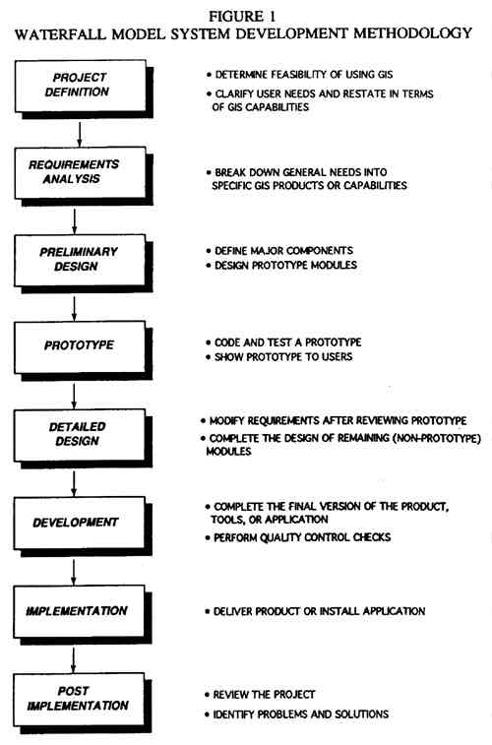
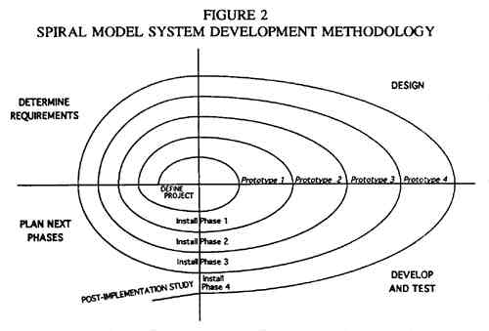
What’s Wrong with the VEE ?
http://libraries.maine.edu/Spatial/gisweb/spatdb/urisa/ur94007.html
Notes:
The VEE is a basic model for systems engineering and integration but unfortunately it is linear and is often called a “waterfall” model as the schedule for a project using the VEE model tends to look like a waterfall as the first activity must be completed before the second and the second before the third etc…Unfortunately the integration and testing happens all at the end. This is why many projects overrun because most of the really difficult problems are only appreciated when the systems integration and testing start.
When the problem allows it, a different approach can be more effective. If the problem can be broken up so that a series of prototypes can address the basic problems in the design in subsets, then a spiral Approach can be used. In the spiral approach, a prototype is defined with a certain set of functionality which is a subset of the total system. This prototype is designed, assembled, integrated and tested . The lessons learned from this activity are then dialed into the next prototype which adds additional functionality. Each generation of prototypes incorporates more functionality ALONG with the lessons learned from the previous prototypes. This results in a final prototype – which is the final operational product, that contains all of the functionality and is well integrated because all of the integration lessons have been learned along the way where the lessons of the integration problems can be incorporated in subsequent prototypes.
At NASA, we called it ”build a little, test a little, fix a little”. Although you build multiple versions of the system, you often get to the end product much faster than by trying to do it all at once.

Slide 18
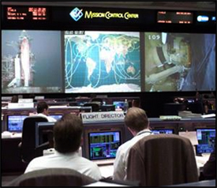
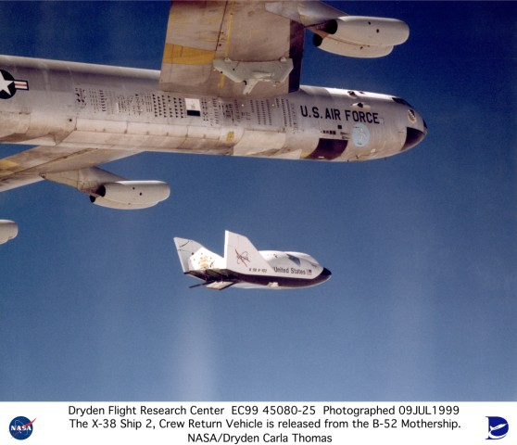
Rapid Spiral Development Methodology
Mature system through building, testing and using a series of prototypes of increasing complexity until all of the required functionality is achieved
  Originally developed by JPL in late 80’s early 90’s
  Used by NASA in the new Mission Control center and then in X-38 project
  Parallel development in DOD led to baselining spiral development methodology in major programs
Tends to work best in software projects with short lead times and small physical assets
  Can work well in hardware development projects – X38
  Have to be able to build things with sufficient functionality to integrate and test
Notes:
The Mission Control Center at the Johnson Space Center struggled with an upgrade from Space Shuttle Only to Space Shuttle-International Space Station Combined Control Center. Close to 10 years of effort in trying to design the final control center had led to nothing. In 1993 a rapid spiral development methodology was used. The first use of a limited control center occurred 18 months later (after 4 iterations) and the full operational center was built a year later (after another 3 iterations).
NASA needed an ambulance and lifeboat for the International Space Station to evacuate crewmembers when the shuttle wasn’t there. Twelve different attempts to start a traditional waterfall program for this vehicle, called a Crew Rescue Vehicle, failed over a 9 year period. In 1995, using the lessons learned from the Mission Control Center, the X-38 project was started. Over the next 7 years, the X-38 project build 4 different prototypes. Three of these were successfully tested in the atmosphere. The fourth prototype was a space vehicle which was built and being readied for a spaceflight test when the program was cancelled because of problems unrelated to the CRV in the Space Station Program. Building the four prototypes was a much faster approach than trying to get a single program approach approved and completed because the problems could be addressed one at a time.
“The only way to eat an elephant is small bites”

Slide 19
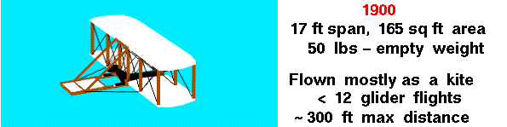
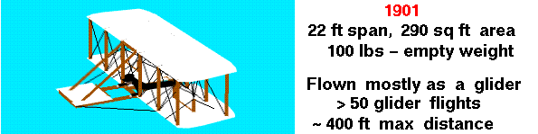
Rapid Spiral Development - Wright Brothers
Overview of Wright Brothers Discoveries
http://wright.nasa.gov/discoveries.htm
Notes:
For over 2000 years humans had tried to fly. Starting in 1900 two brothers in Ohio decided that the problem of flight could be conquered if the issues were isolated and dealt with one at a time. Although the Wright Brothers are often described as “bicycle mechanics” they were actually brilliant systems engineers. They broke the problem down into a series of problems in stability and control, aerodynamics, structures, and propulsion and addressed each one in a series of prototypes. Starting with kites, then small gliders ands eventually bigger gliders an powered vehicles, they systematically attacked the problems and got to a working vehicle in 5 years. It is worth noting that at the same time that the Wright Brothers were building their prototypes and succeeding, a much larger government funded effort led by Samuel Langley, curator of the Smithsonian, failed spectacularly because it went from a single small scale model to a full scale version without addressing the key technical questions,

Slide 20
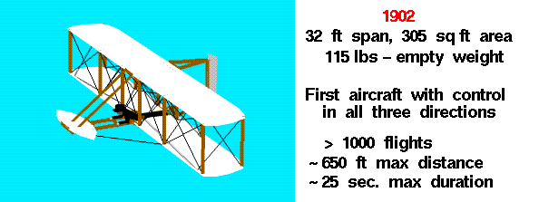
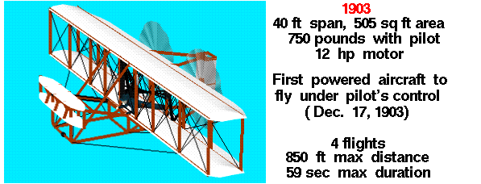
Notes:
The 1901 glider did not perform as expected. Following the 1901 effort, one of the Wright brothers despaired that “men would not fly for a thousand years”. But the Wrights went back to Ohio and constructed a wind tunnel where they tested their wing shapes and found errors in the physics of the time which were causing overpredictions in their wings lift. They corrected the physics, designed new wings and their 1902 glider performed as their predictions at Kitty Hawk NC. They went back to Ohio and designed an efficient lightweight engine and propellers and returned the next year to successfully fly the first human heavier than air flight in December 1903.

Slide 21
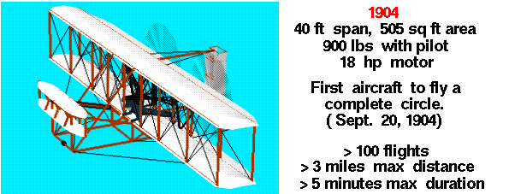
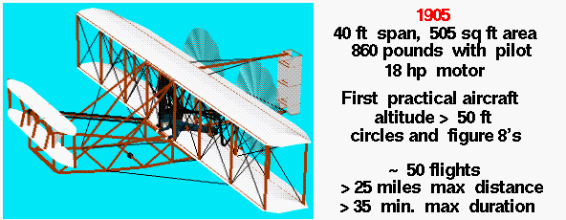
Notes:
The Wright Brothers continued to improve their vehicle with new prototypes over the next two years until by 1905 they had successfully conquered the problem of heavier than air flight.

Slide 22
Any Questions ?

